Slide 1
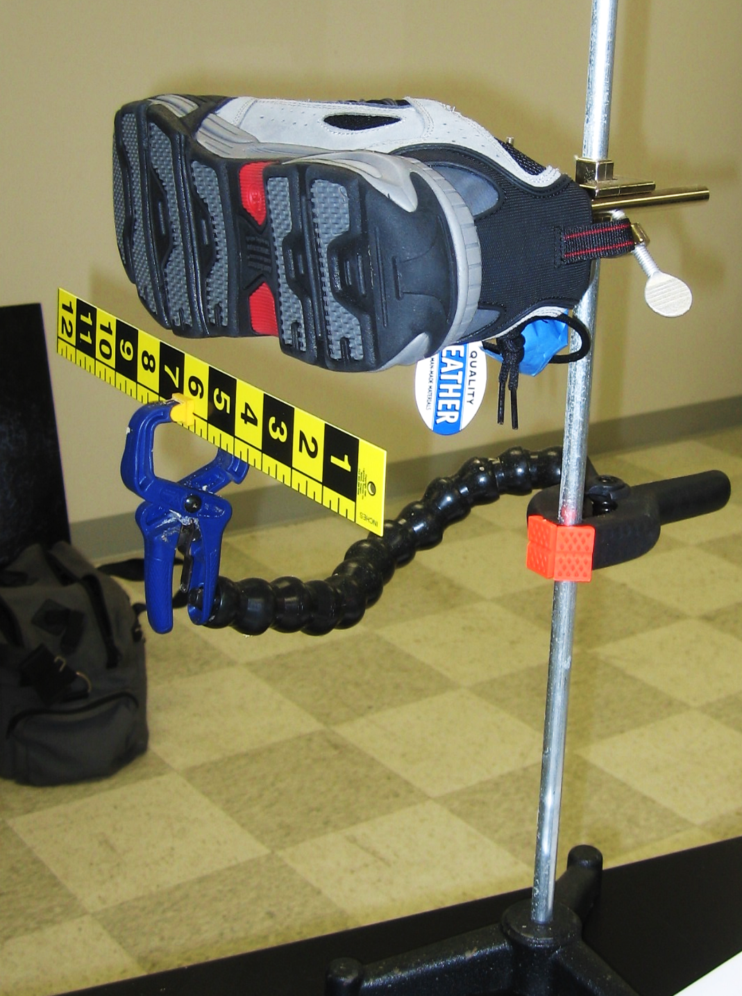
Linking Feet to Shoes: Lessons from a Case Study and Adult Twin Research: Part 5
Michael Nirenberg, DPM
DrNirenberg@FriendlyFootcare.com

Slide 2
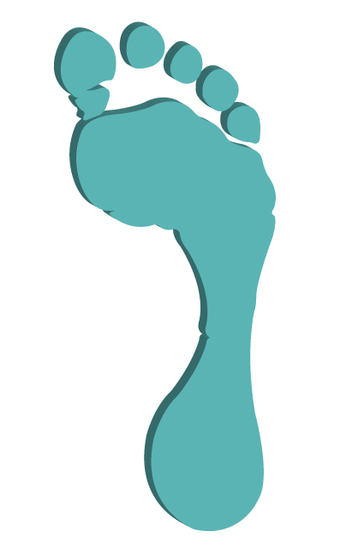
Overlay
Comparisons

Slide 3
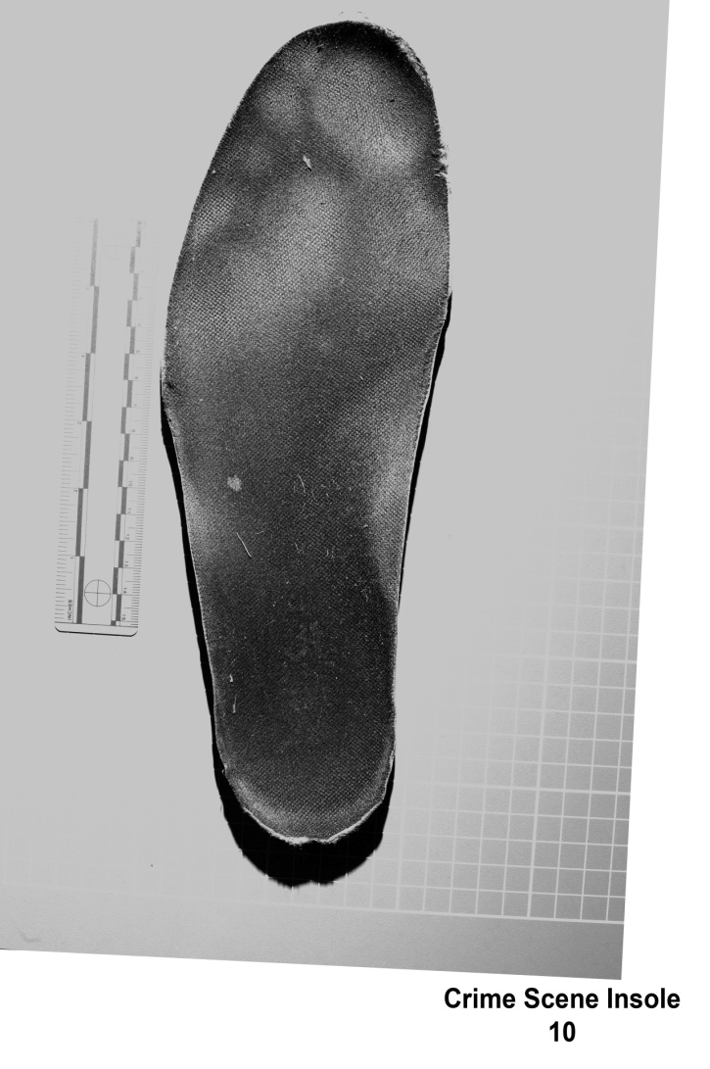
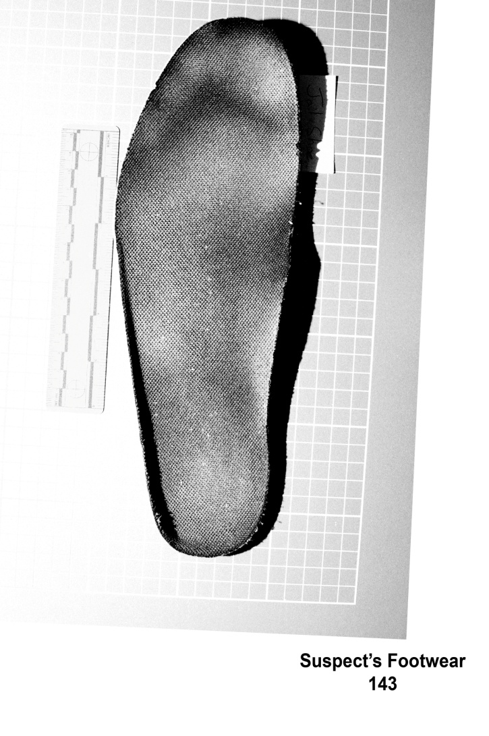
Overall Shape – Heel, Arch & Ball
Images Adapted from Images by Smithfield Virginia PD

Slide 4
Toe Positions
Images Adapted from Images by Smithfield Virginia PD

Slide 5
Toe Shape - Especially 1 and 5
Images Adapted from Images by Smithfield Virginia PD

Slide 6
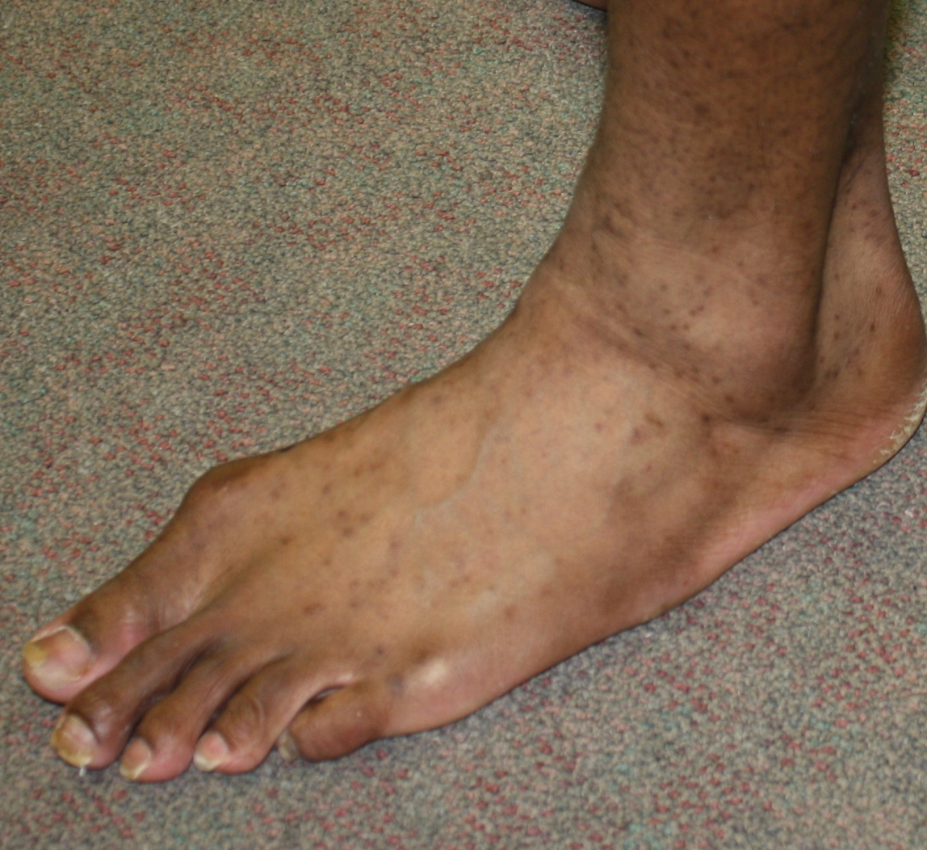
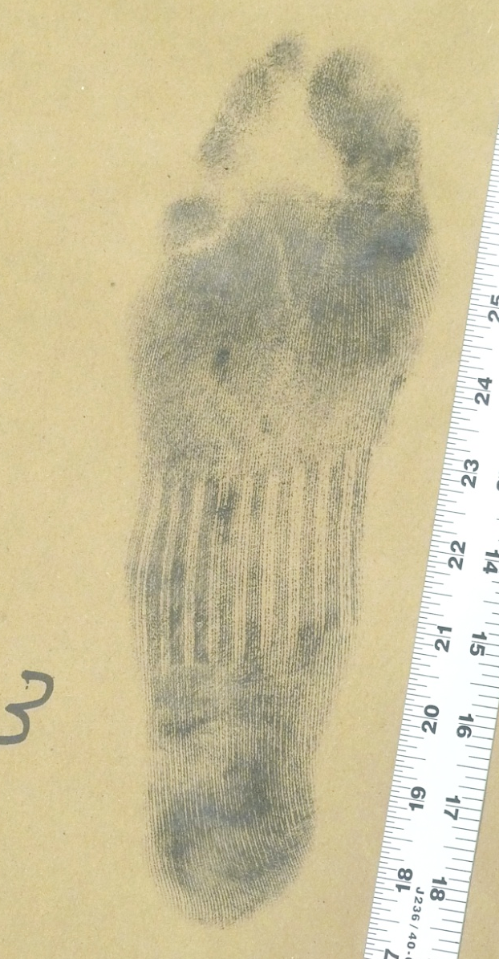
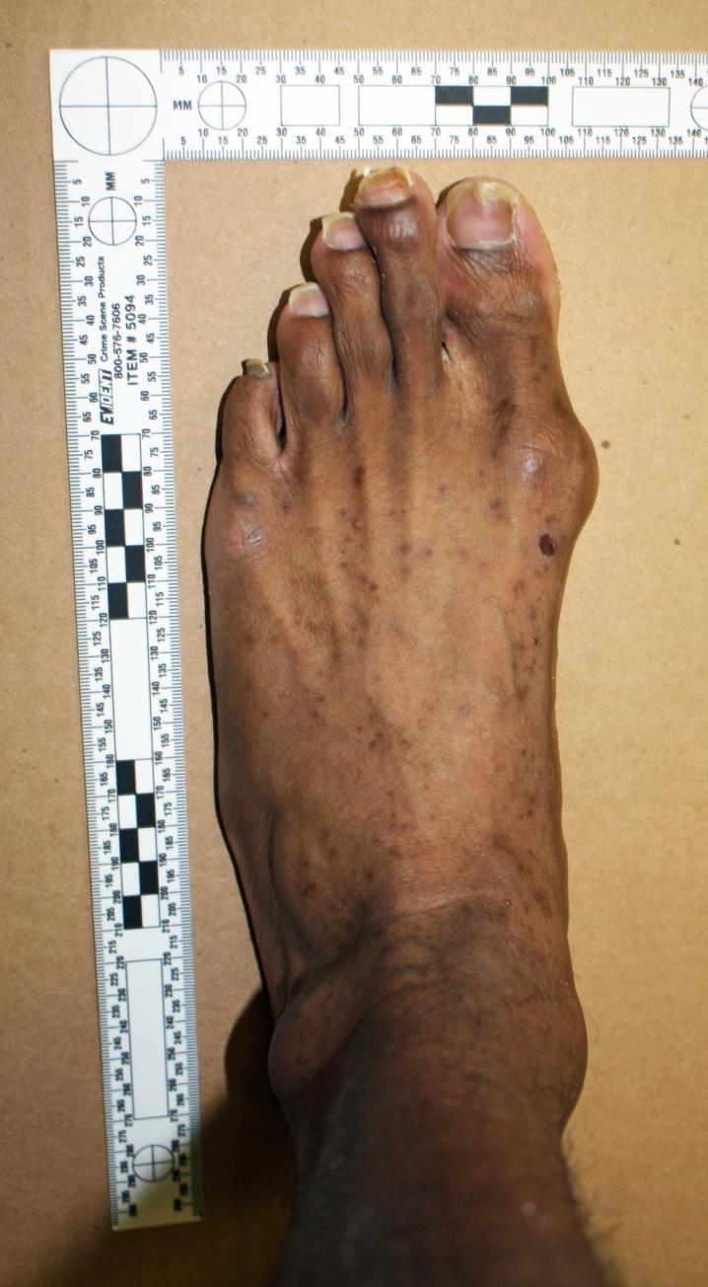
Suspect

Slide 7
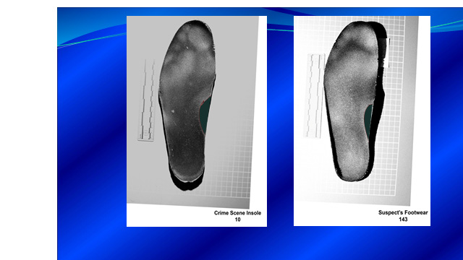
Suspect’s insole length 1.6mm shorter
Could 1.6mm account for differences?
Images Adapted from Images by Smithfield Virginia PD

